Slide 1

E-commerce data analysis

Slide 2
Introduction
This analysis deals with a transnational data set which contains all the transactions occurring between 01/12/2010 and 09/12/2011 for a UK-based and registered non-store online retail.
The company mainly deals with the sale of unique all-occasion gifts.
Many customers of the company are wholesalers.

Slide 3

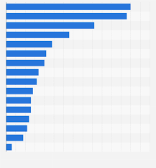
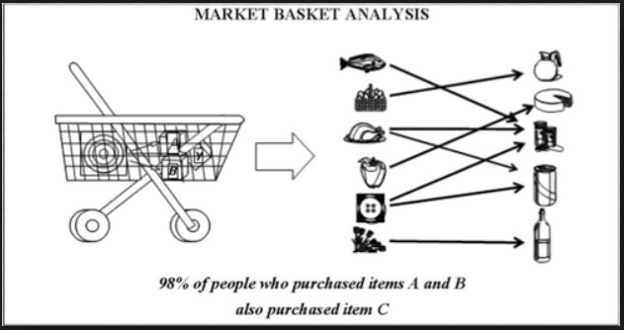



Agenda
1
2
3
4
5
6

Slide 4
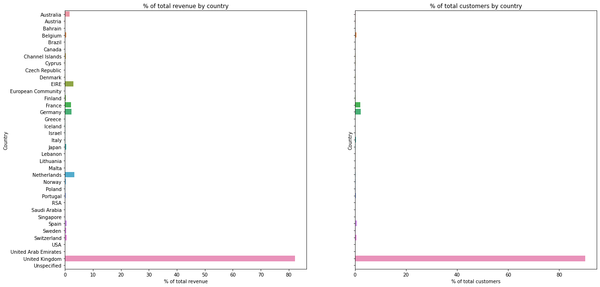
Percentage of sales with respect to countries and customers

Slide 5
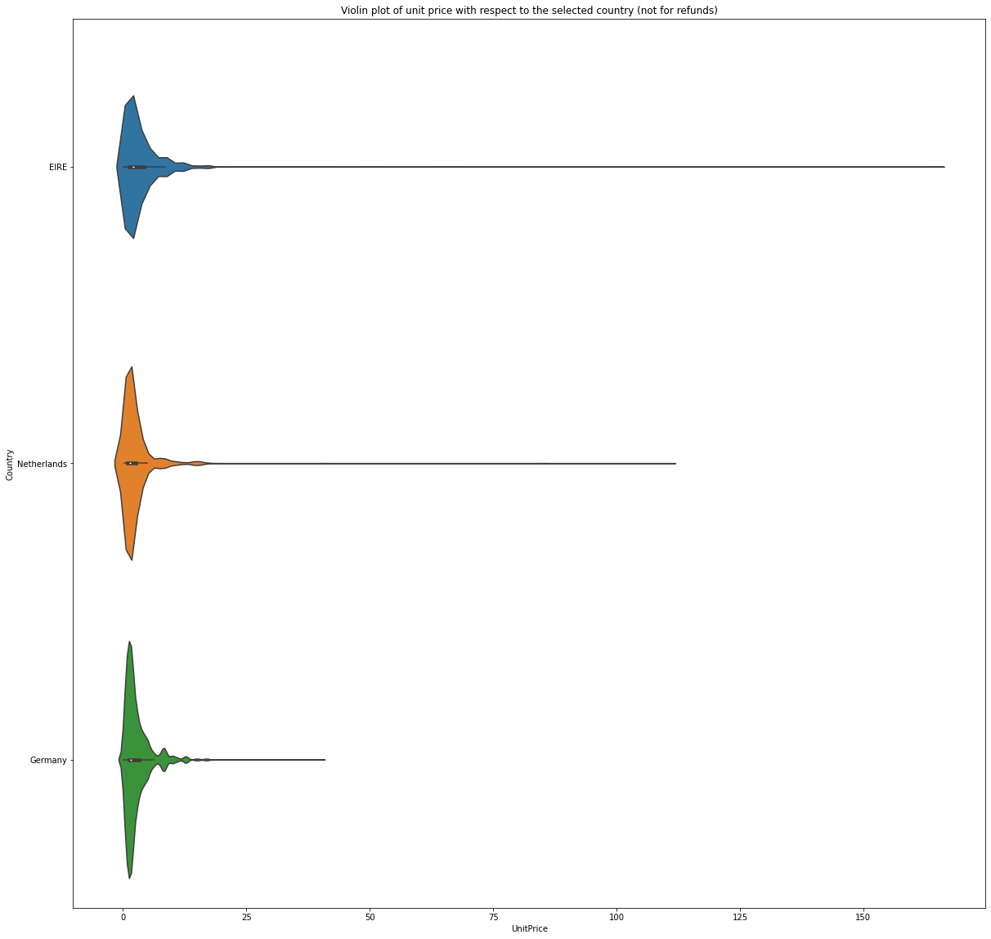
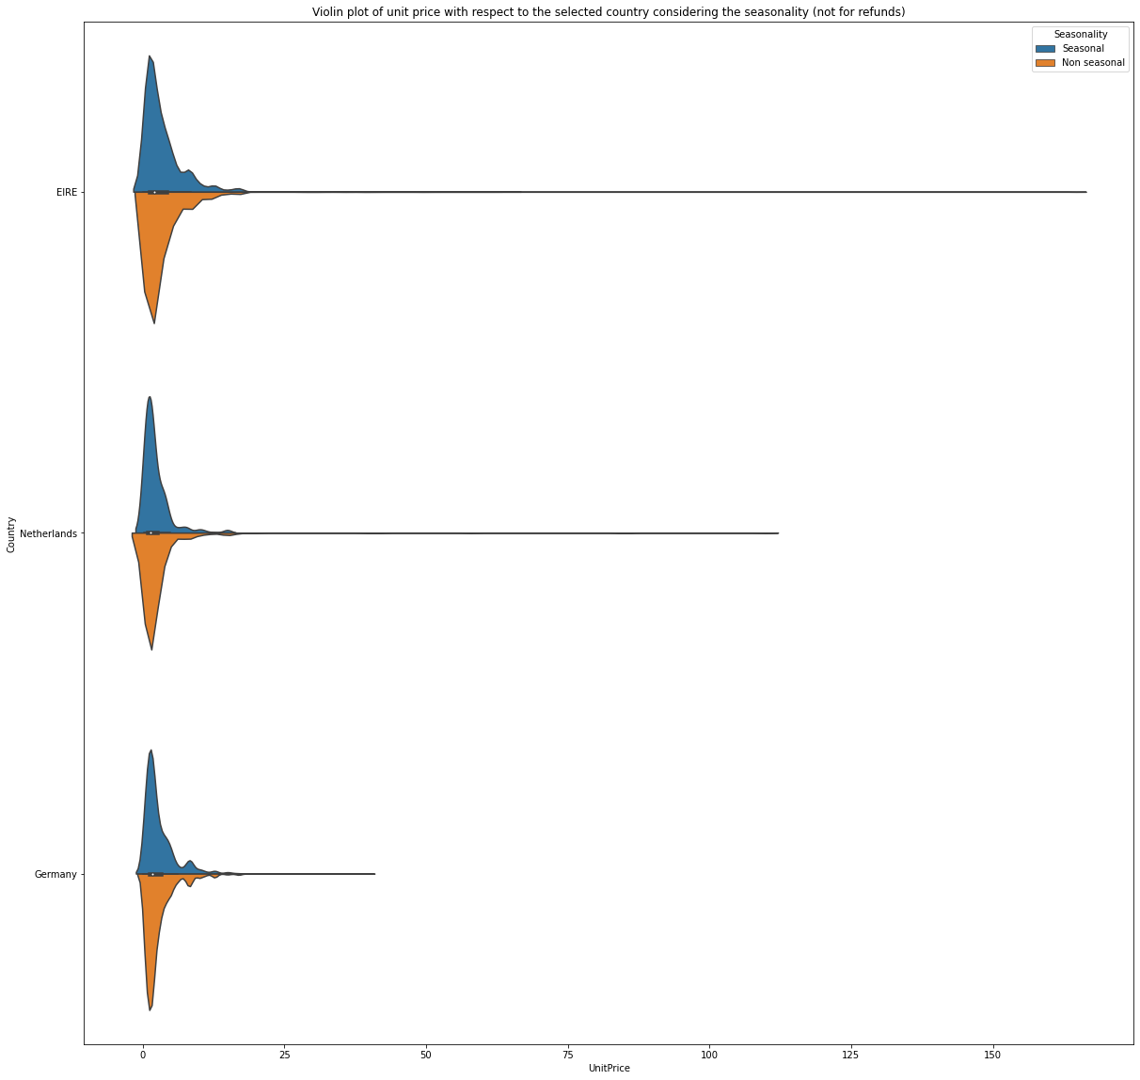
Country wise breakdown
Unit price with respect to the selected country
Unit price with respect to the selected country considering the seasonality

Slide 6
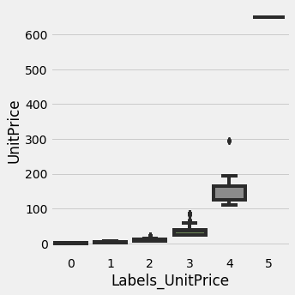
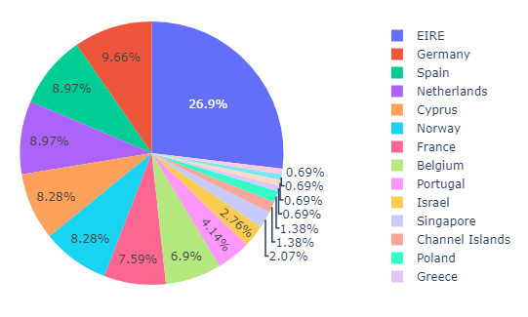
Highly profitable products

Slide 7
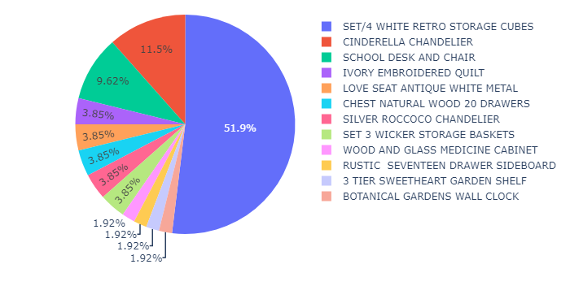
Highly profitable products

Slide 8
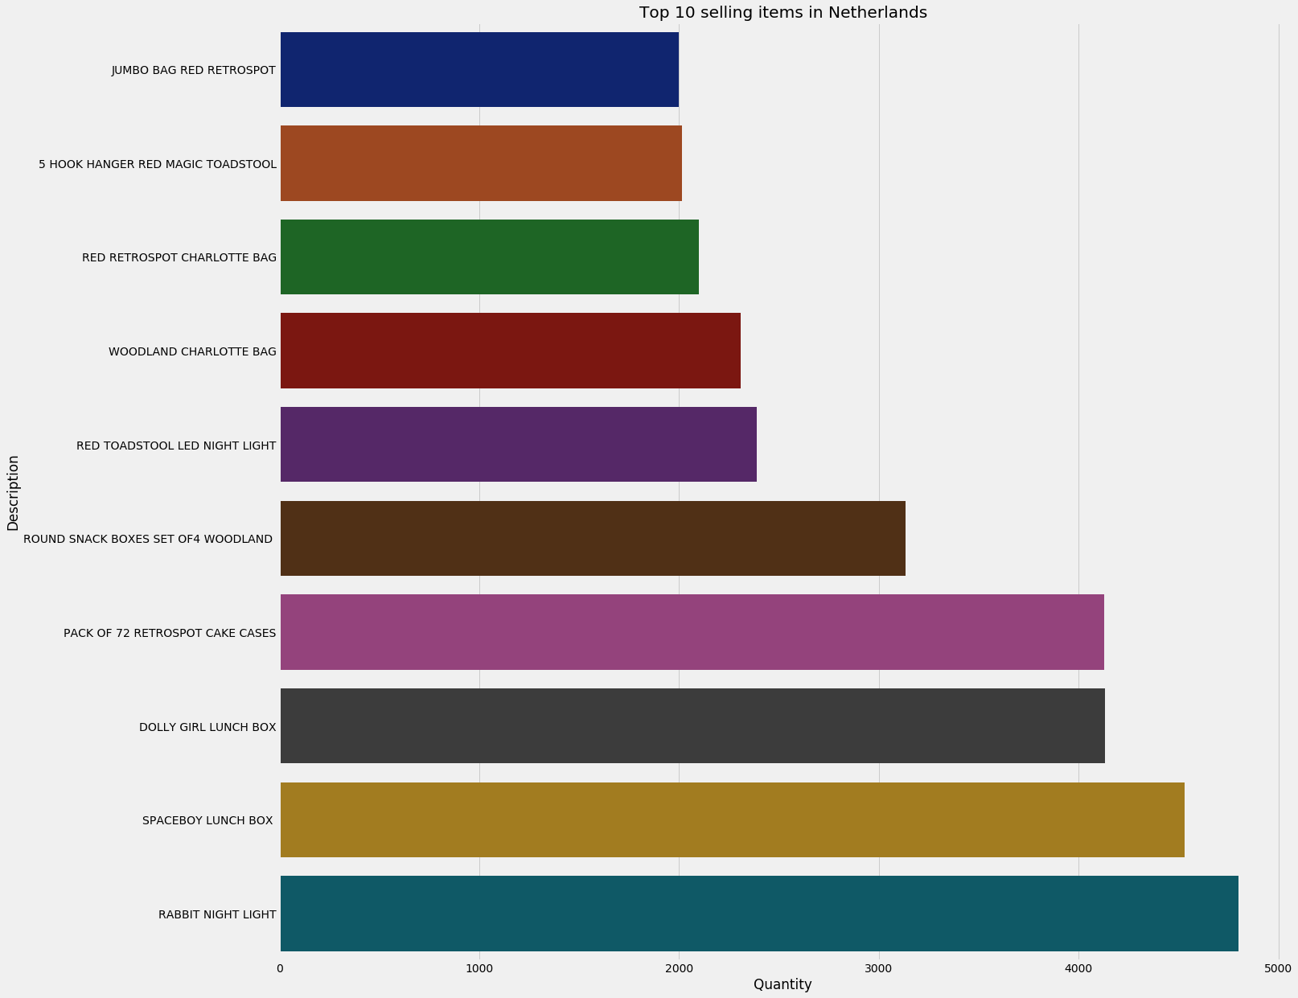
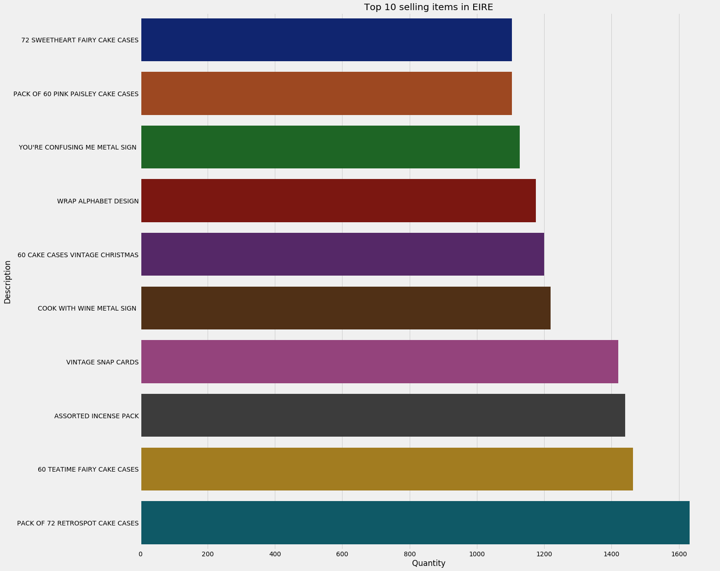
Top 10 selling products - I

Slide 9
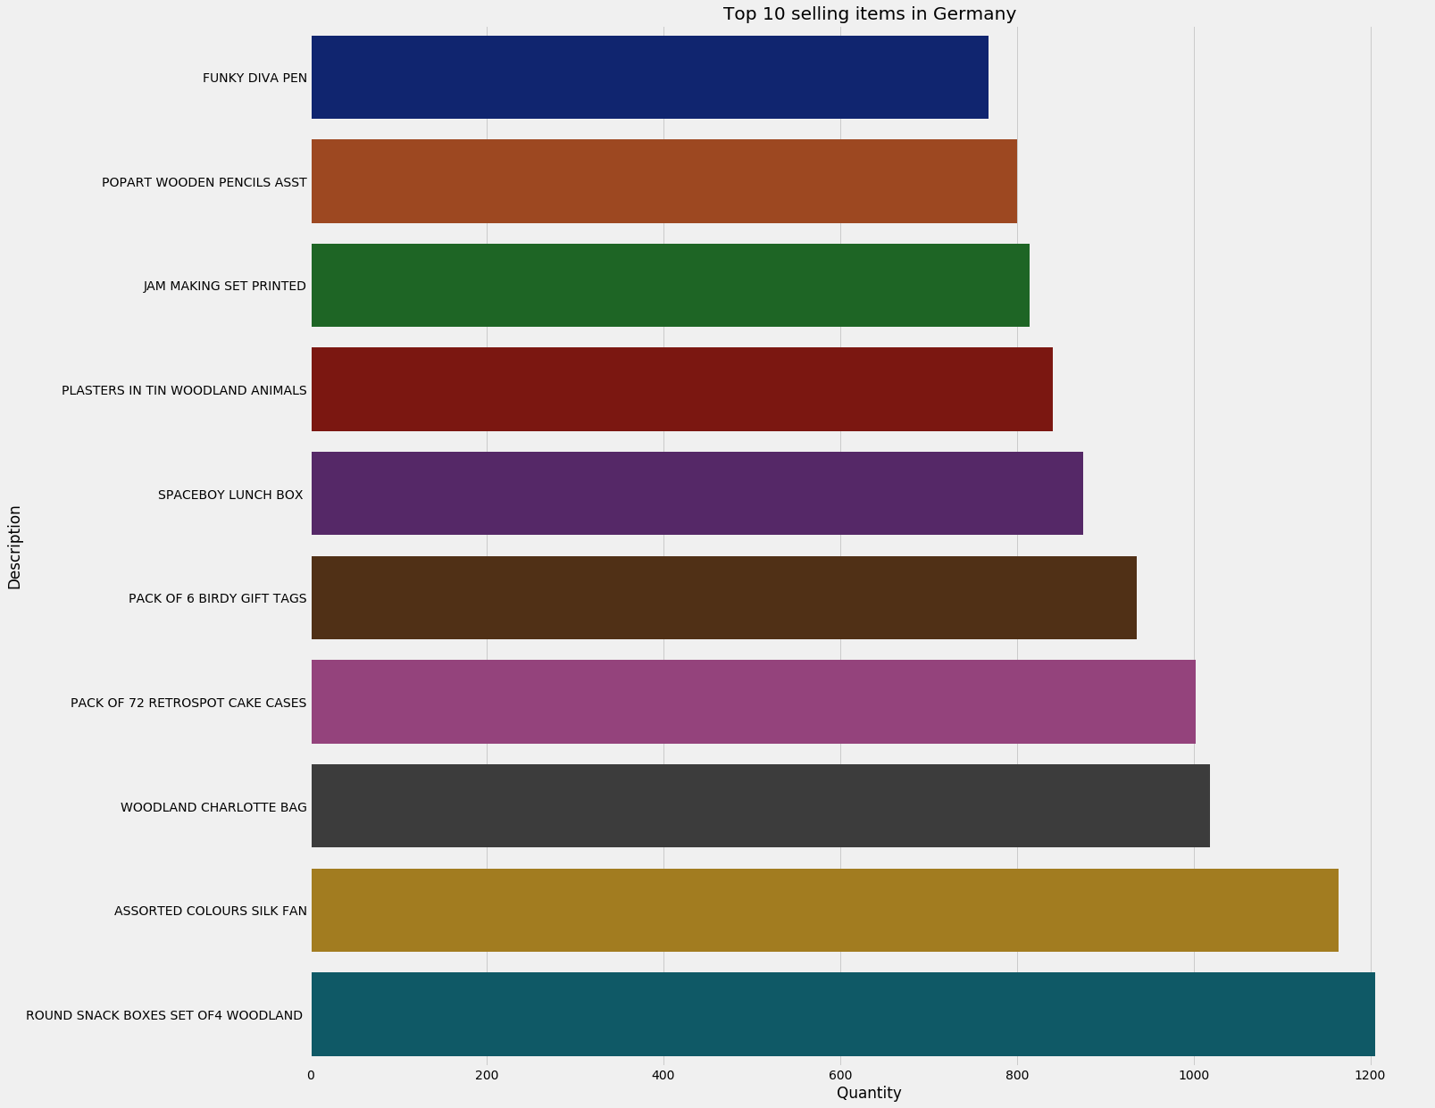
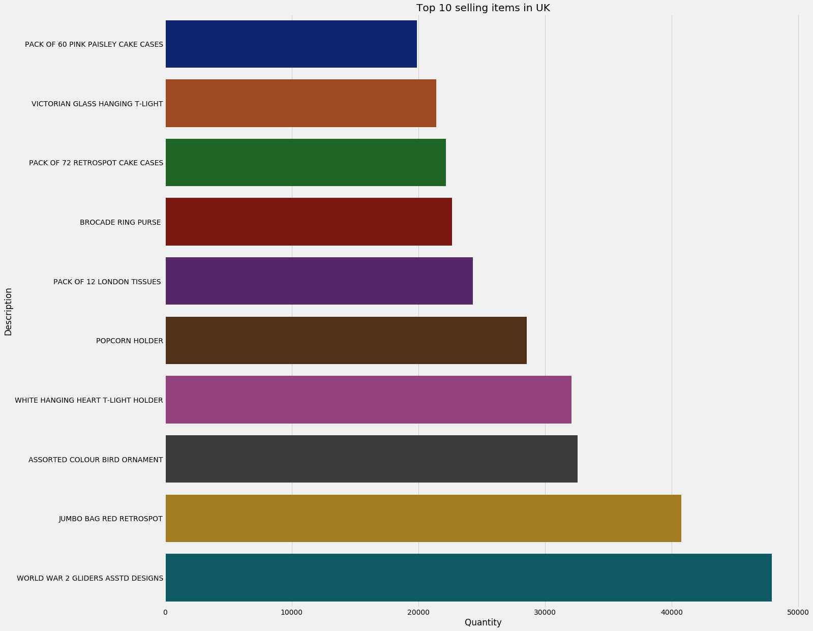
Top selling products - II

Slide 10
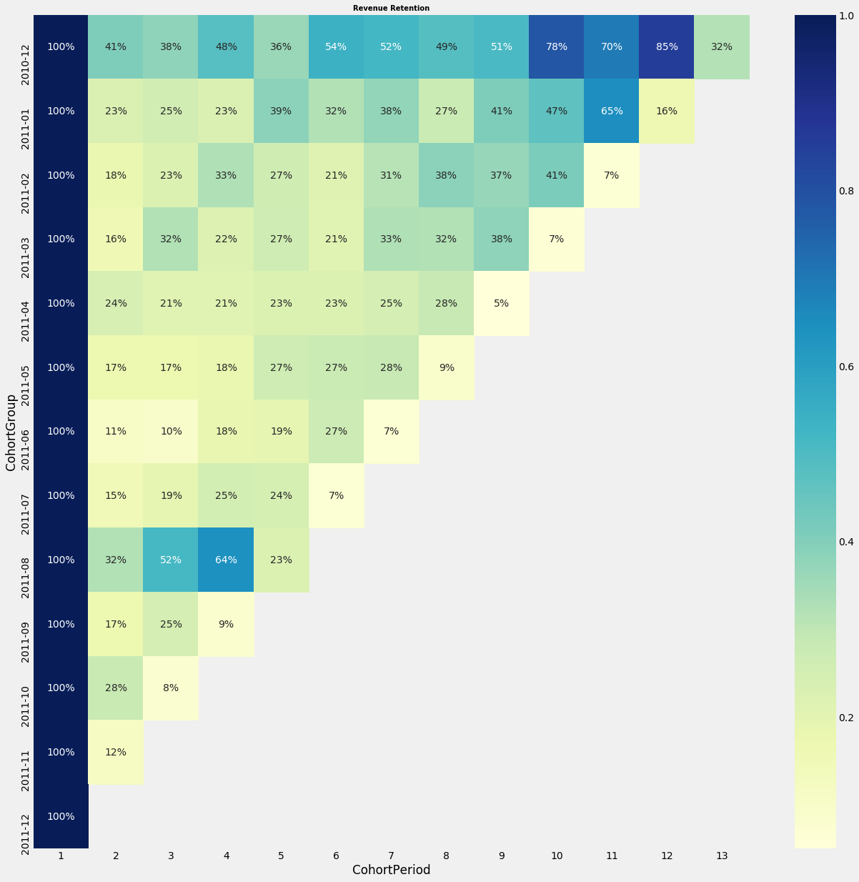
Revenue retention

Slide 11
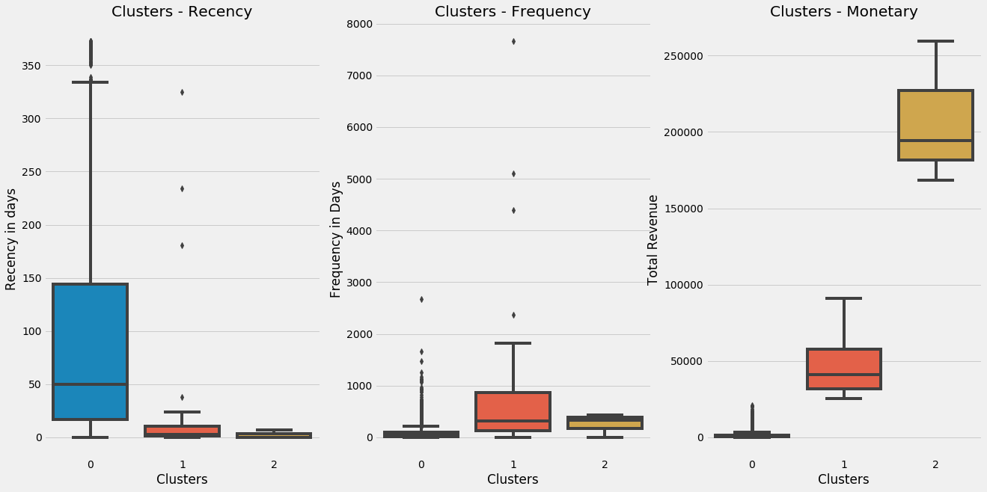
Clustering of sales

Slide 12
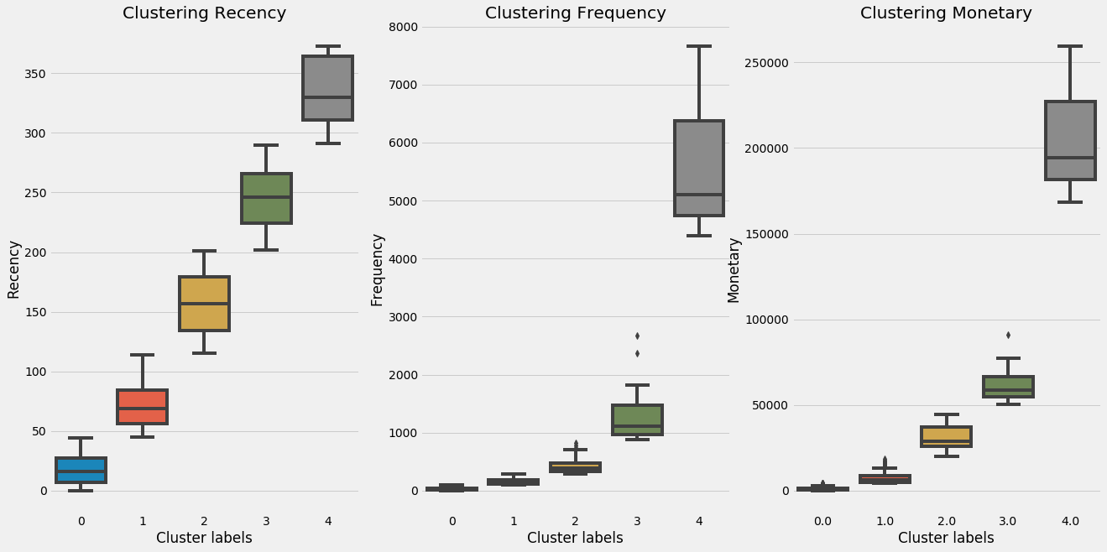
Targeted marketing - I

Slide 13
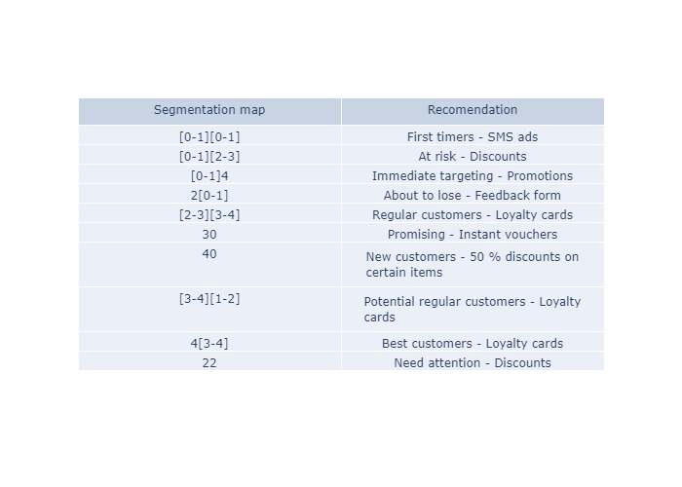
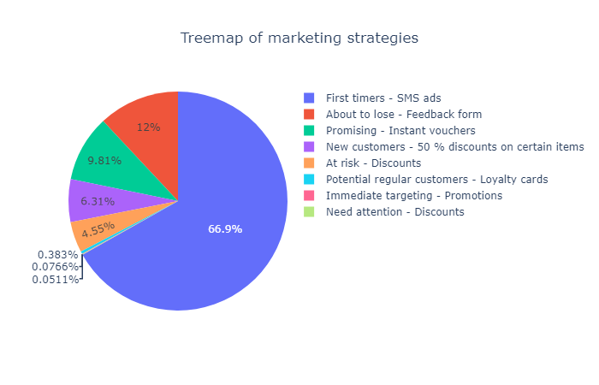
Targeted marketing - II

Slide 14
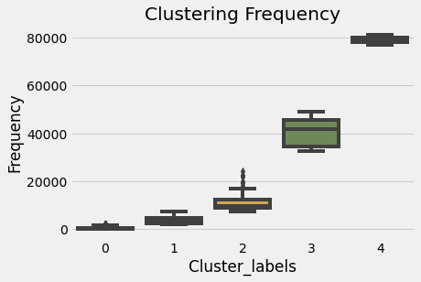
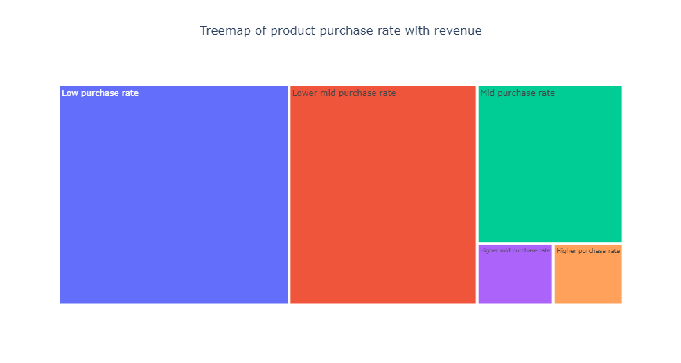
Nature of purchases

Slide 15
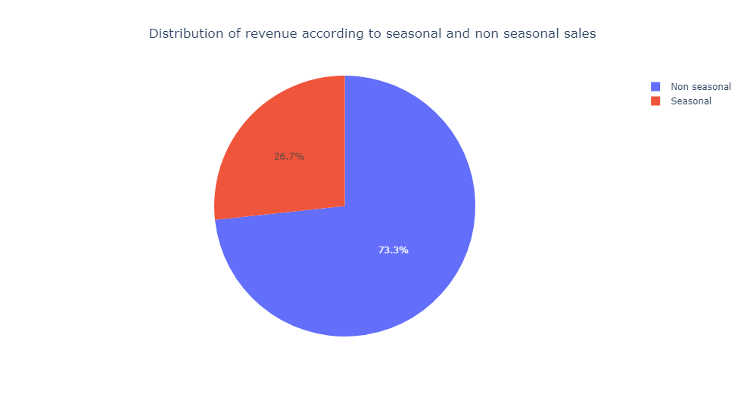
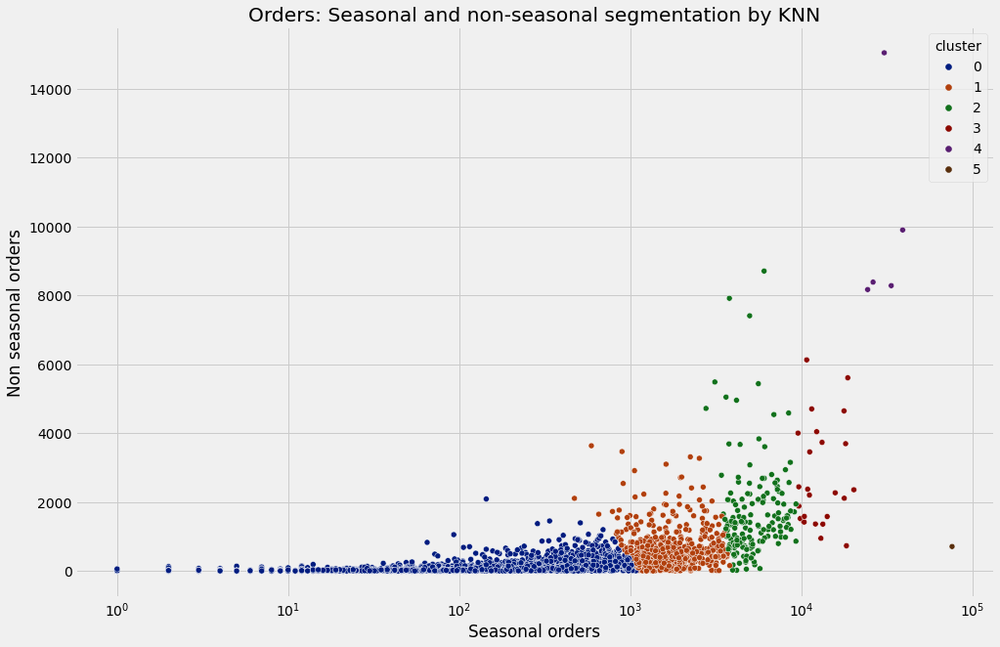
Distribution of sales and clustering of segments

Slide 16
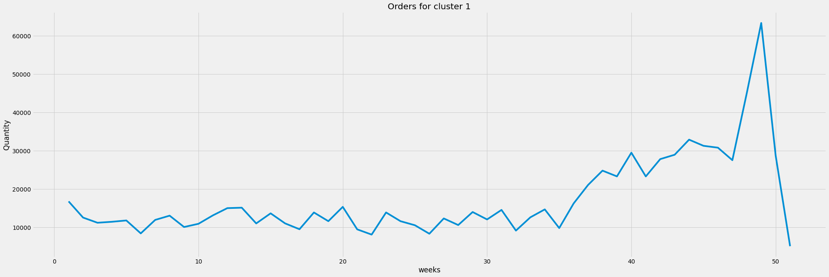
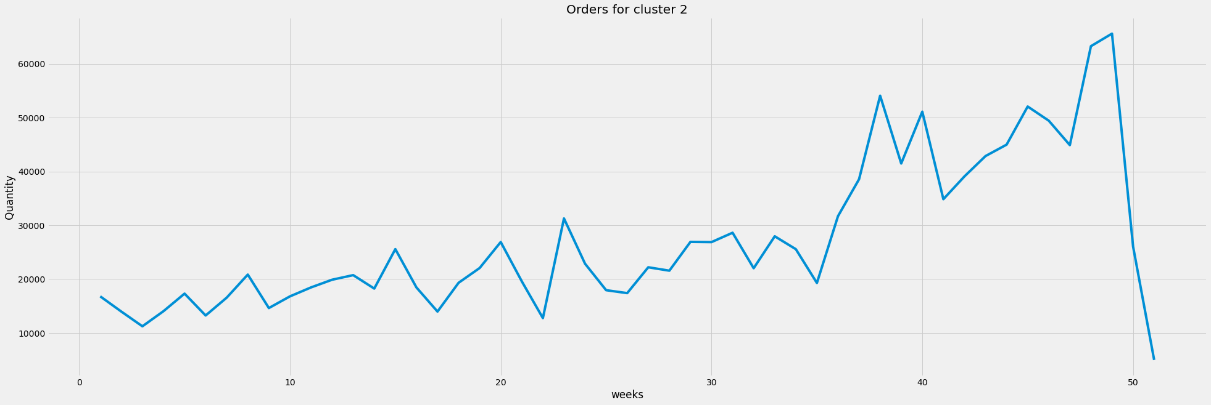
Pattern of orders in each cluster - I

Slide 17
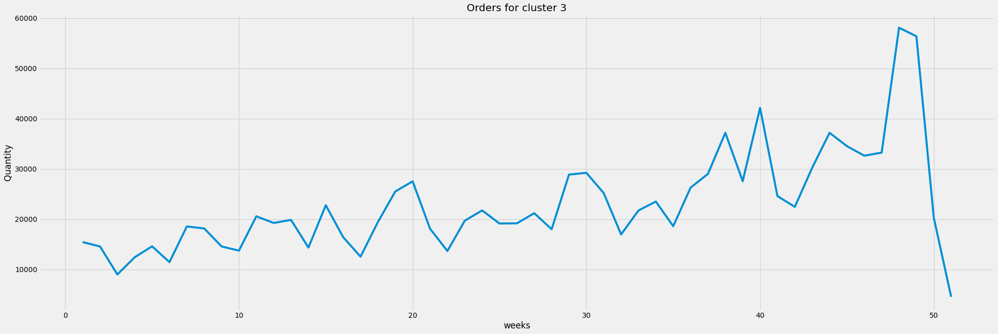
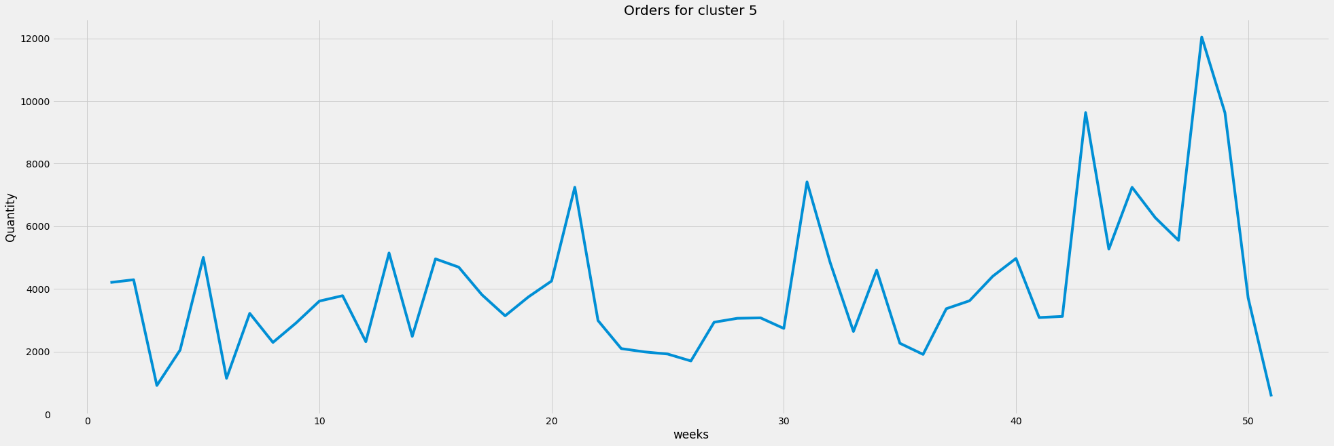
Pattern of orders in each cluster - II

Slide 18
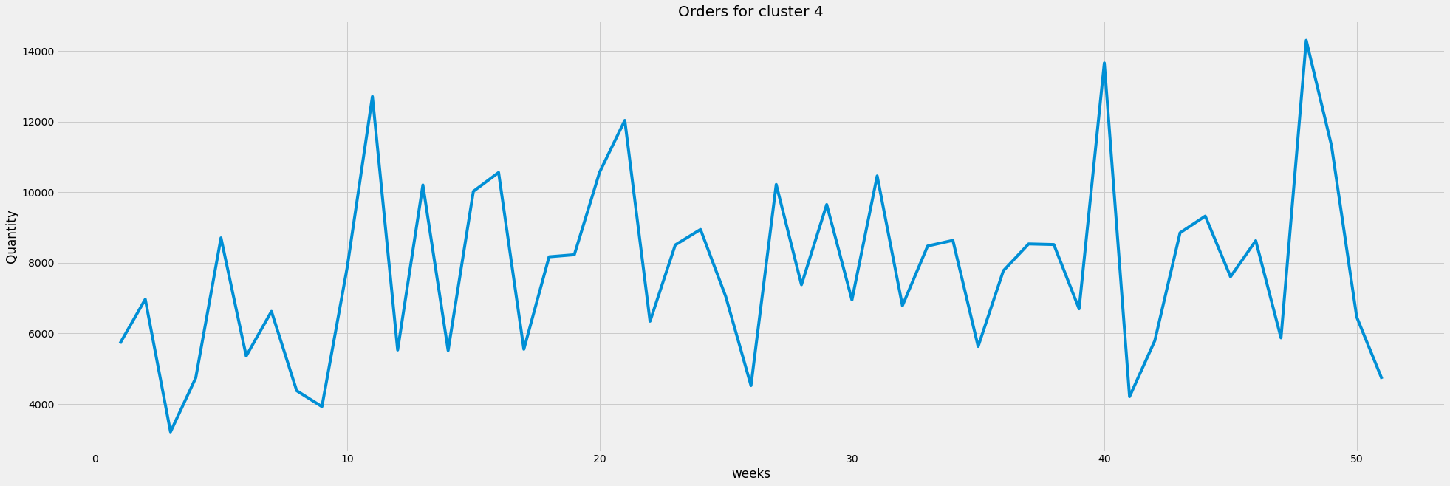
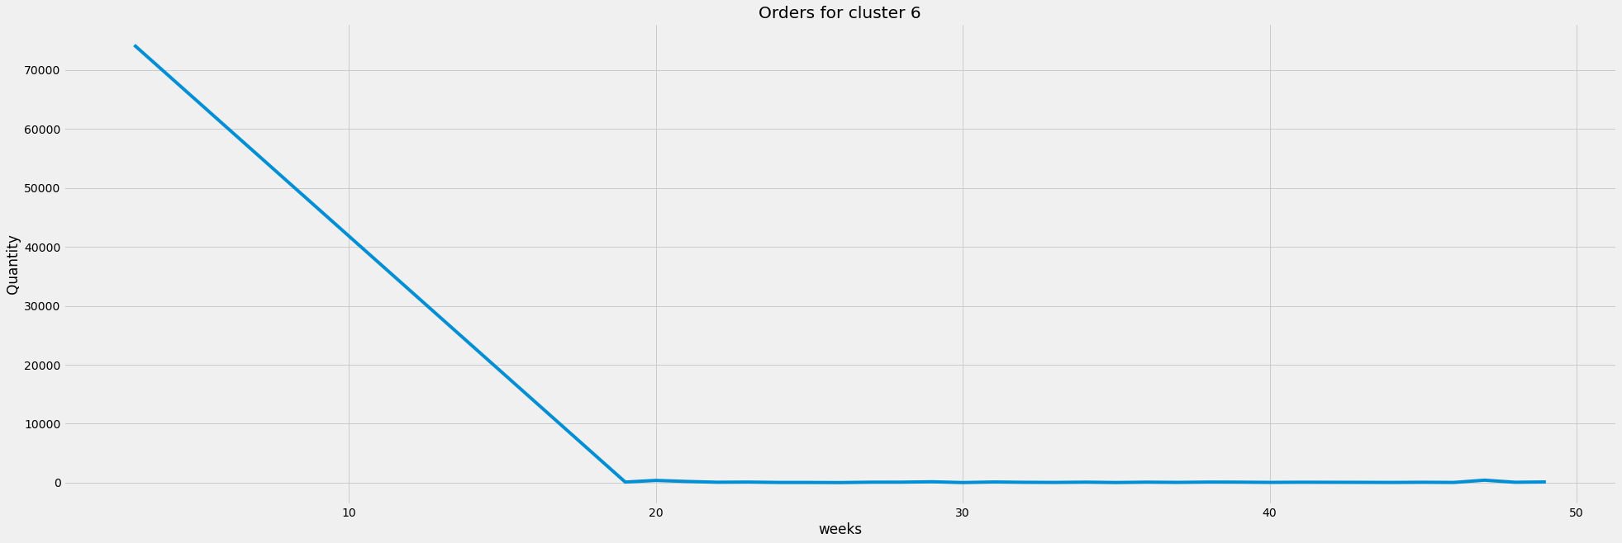
Pattern of orders in each cluster - III

Slide 19
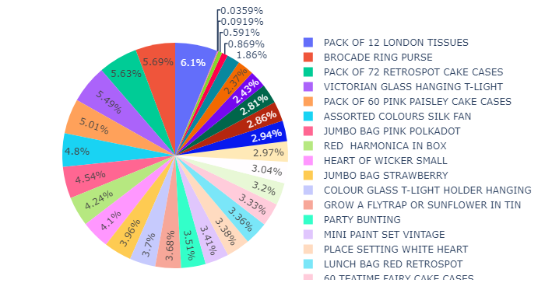
Distribution of products which have a demand throughout the year

